Slide 1


JAVA 25 – NEW FEATURES
Notes:
Hello folks, today I will talk about Java 25, new features. More specifically the new features.

Slide 2

AGENDA
Java LTS Versions
New Features
Notes:
Here is our agenda for this lunch and learn, we will start to explain what is LTS version, and after that we will enter in new features of Java 25, will see each one these new features and try to compare with last LTS version which is Java 21

Slide 3
LTS Versions
LTS means Long-Term support.
updates and support to for a long period about 3 Years
LTS Versions are Java 8, Java 11, Java 17, Java 21 and now Java 25
It is a trend to reduce this time space between LTS launches. How we can see
8 to 11 (4 Years), 11 to 17 (3 Years), 17 to 21 (2 Years), 21 to 25 (2 Years), by now Oracle trend to maintain this often of lts launches
Notes:
LTS means Lont-Term support. So what?
Well in other words, this version will receive updates and support to performance improvement and security fixes

Slide 4
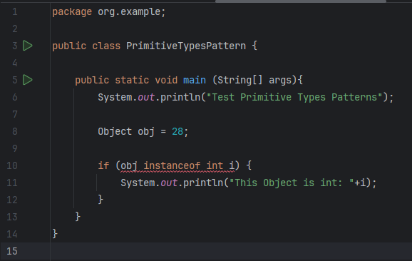
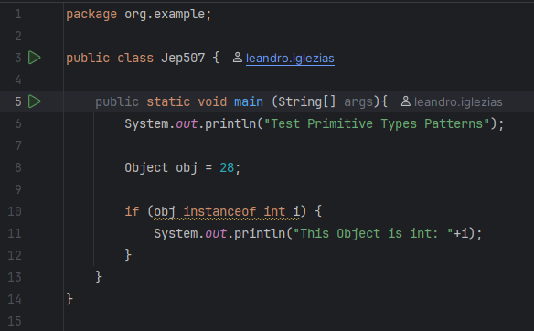
Java 25 new Features
Primitive Types in Patterns (JEP 507 – Preview)
We can now use primitive types in instance of
Java 21
Java 25

Slide 5
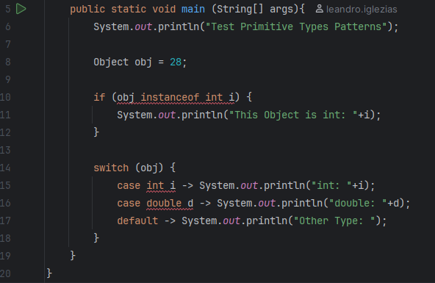
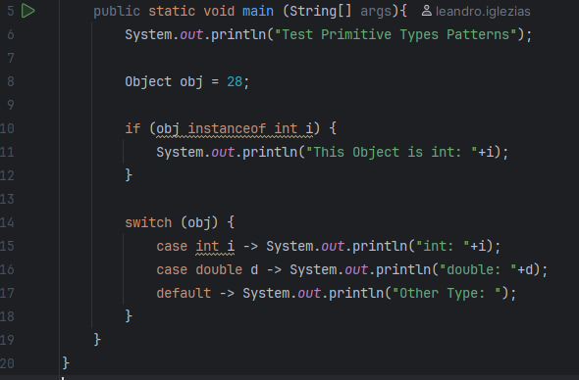
Java 25 new FEatures
Primitive Types in Patterns (JEP 507 – Preview)
We can now use primitive types switch-case
Java 21
Java 25

Slide 6
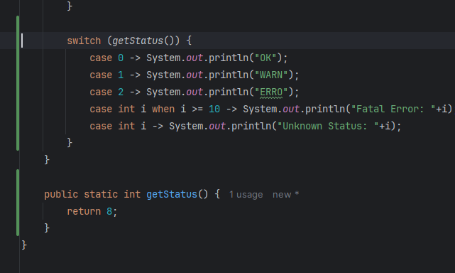
Java 25 new FEatures
Primitive Types in Patterns (JEP 507 – Preview)
We can now use primitive types switch-case
Java 25

Slide 7
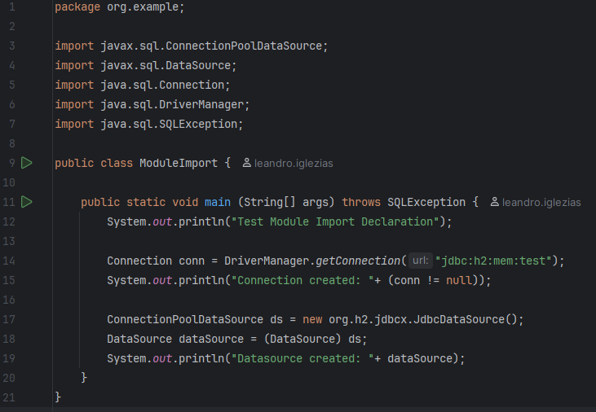
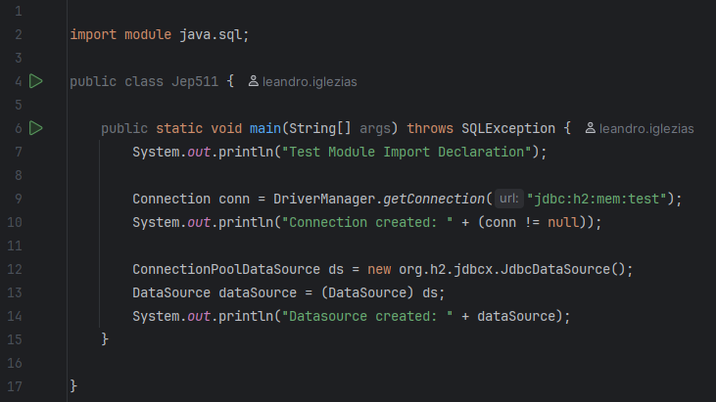
Java 25 new FEatures
Module Import (JEP 511)
Reduce number of import lines
Java 21
Java 25

Slide 8
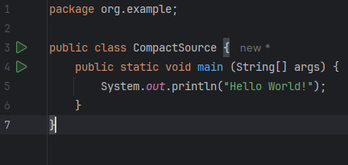
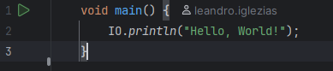
Java 25 new FEatures
Compact Source Files and Instance Main Methods (JEP 512)
Developers can omit package and module declarations
A compact source file declares a class implicitly
Allow main to be non-static, and drop the requirements for public and an array parameter
Java 21
Java 25

Slide 9
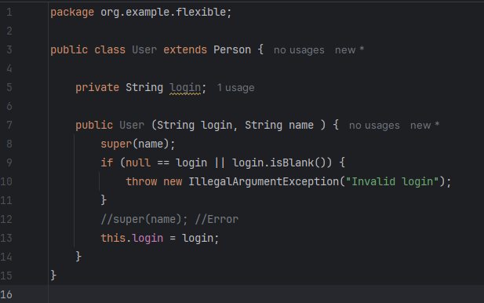
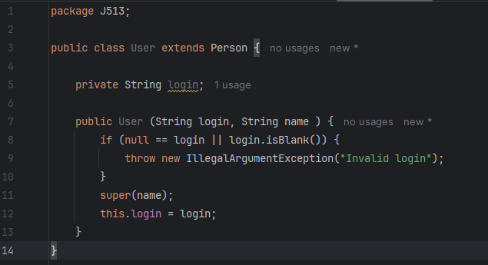
Java 25 new FEatures
Flexible Constructor (JEP 513)
Superclass constructors no longer need to be the first line of class constructor.
Java 21
Java 25

Slide 10
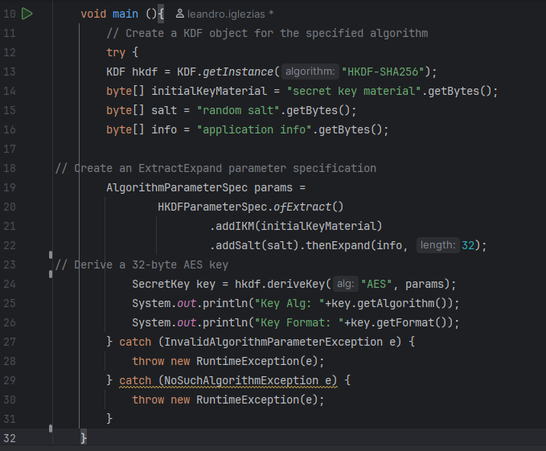
Java 25 new FEatures
Key Derivation Function API(JEP 510)
Provides a standard API (javax.crypto.KDF) for deriving Keys
Official support for KDFs (e.g. HKDF) directly in the JDK.
Unified usage instead of relying on external libraries or homegrown implementations
Java 21
Java 25

Slide 11
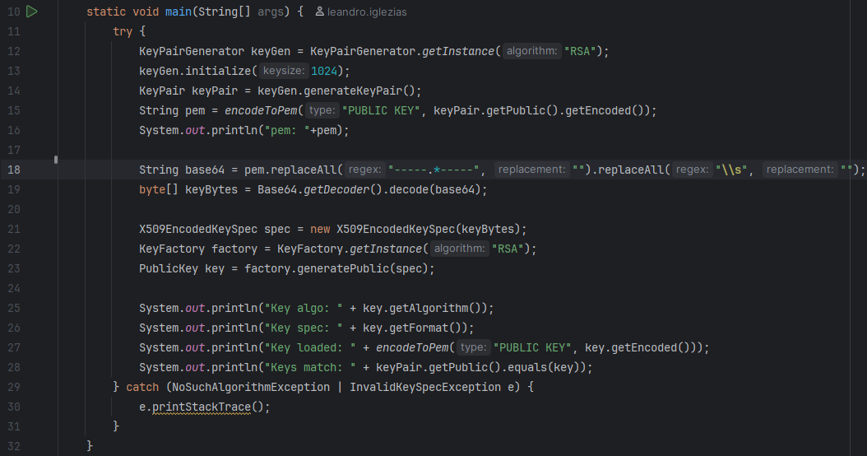
Java 25 new FEatures
PEM (Privacy-Enhanced Mail) Encoding (JEP 470 - preview)
API for encoding objects that represent cryptographic key
Simplify integration with authentication and security systems
Java 21
Java 25

Slide 12
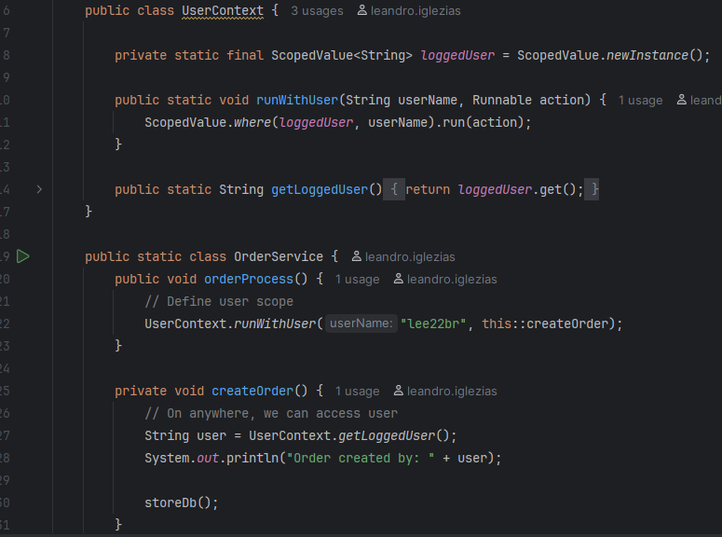
Java 25 new FEatures
Scoped Values (JEP 506)
More efficient way to share immutable data between threads
Java 21
Java 25

Slide 13
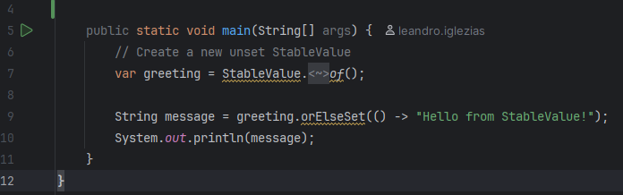
Java 25 new FEatures
Stable Values (JEP 502 - preview)
Kind variable that hold immutable data
Treated as constants by the JVM
Flexibility as to the timing of their initialization
Java 21
Java 25

Slide 14
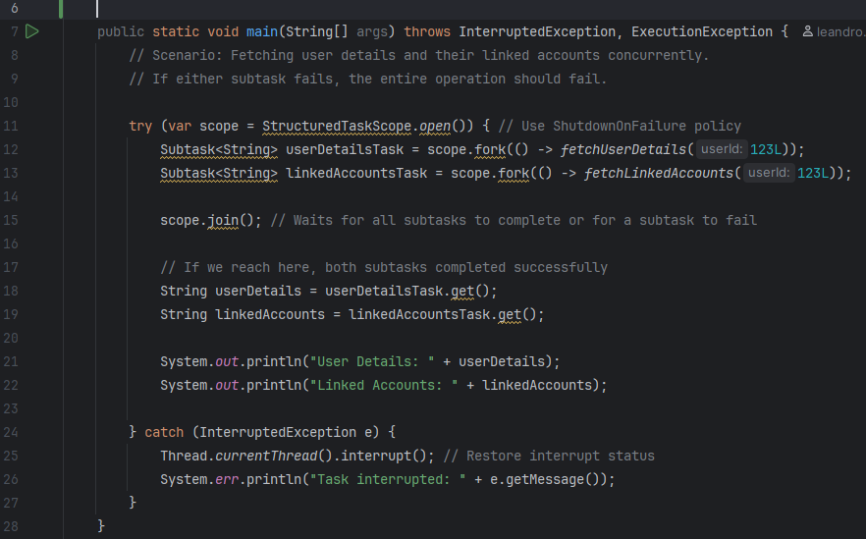
Java 25 new FEatures
Structured Concurrency (JEP 505 - preview)
Simplify concurrent programming
Groups of related tasks running in different threads as single units of workFlexibility as to the timing of their initialization
Java 21
Java 25

Slide 15
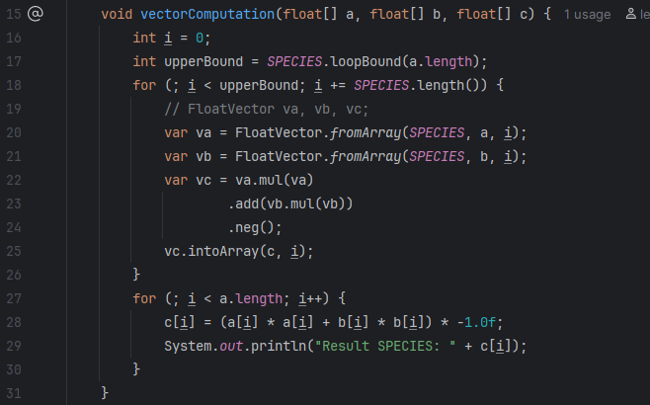
Java 25 new FEatures
Structured Concurrency (JEP 508 - Incubator)
API to express vector computations that reliably compile at runtime to optimal vector instructions on supported CPUs
achieving performance superior to equivalent scalar computations
Java 21
Java 25

Slide 16
Generational Shenandoah – (JEP 521)
This improvement aims to optimize performance, especially in memory-intensive and latency-sensitive workloads
Grouping objects into young and old generations for more efficient memory management.

